Slide 1

AGROWEEDER
AICTE
Chhatra Vishwakarma Awards 2019
TEAM PRAYAAS (VISH20195426)
Yash Sudhir Shirke
Udayraj Sambhaji Gawade
GUIDED BY
Mrs. Deepali Jadhav

Slide 2
Introduction
With the growing needs of convenience, technology now tries to seek automation in every aspect possible.
We present a self-driving Agroweeder which would eradicate human intervention in the field of driving.
The Agroweeder would drive itself from one place to the other on its own it would possess integrated features like lane-detection, automatic weed remover ,tilling of land ,etc. This features would help the Agroweeder drive itself to the mentioned destination on the track properly, avid collisions, provide live streaming of the view in front of it with the help of camera mounted over the Agroweeder.

Slide 3
Identification and Justification of Problem:
Replacing human labour with automation is growing trend across the entire world. According to survey, the world population is increasing tremendously. With increase in population there is need of increase in food production.
Agriculture sector becomes inefficient due to traditional methods of farming. To improve the quality and quantity of agriculture products and to minimize the human efforts, we need to make use of intelligent and automatic machinery for agricultural activities.
So as modern citizens of country, we have deigned AgroWeeder: Self power weeder based on Raspberry Pi for farmers.

Slide 4
Requirements
Hardware Requirements :-
Raspberry pi 3b+
Pi camera
Ardiuno uno R3
Ultrasonic sensor
2 x motor driver
12v Battery
Wheels
Motors
Software Requirements :-
Python 3
Open CV
Ardiuno IDE
Operating System: - Raspbian

Slide 5
Working
The Agroweeder is a farm based machine which is used for tilling the land and the removing weeds from the land.
The Agroweeder works on a simple small board processor raspberry pi 3b+. When the Agroweeder gets start the pi camera captures the live streaming of the field and sends the information to the raspberry pi.
Then raspberry pi process the video, and sends the command to the arduino using GPIO pins.
Then the arduino process the command and send the command to both the motor drivers.
The first motor is use for running of Agroweeder.
And the second one is used for controlling the weeding tools which is fixed behind the Agroweeder.

Slide 6
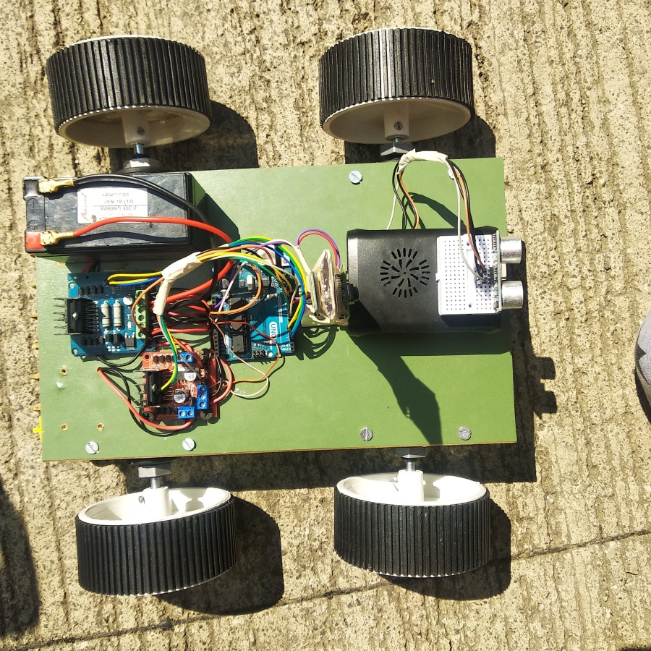
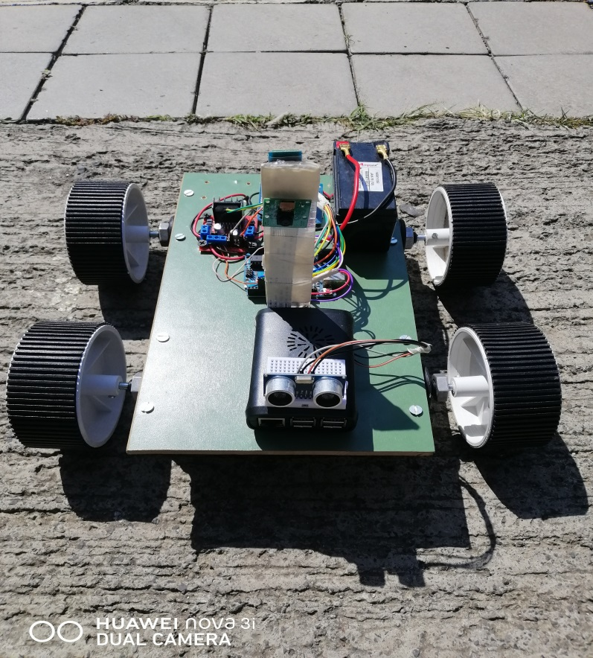

Slide 7
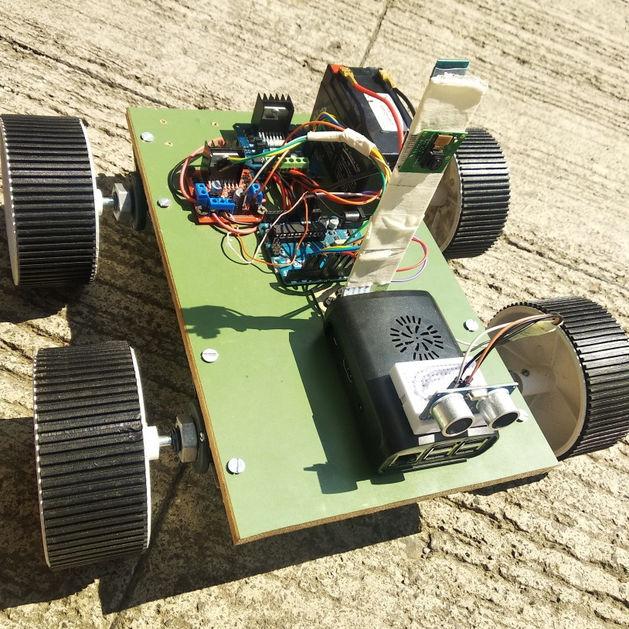
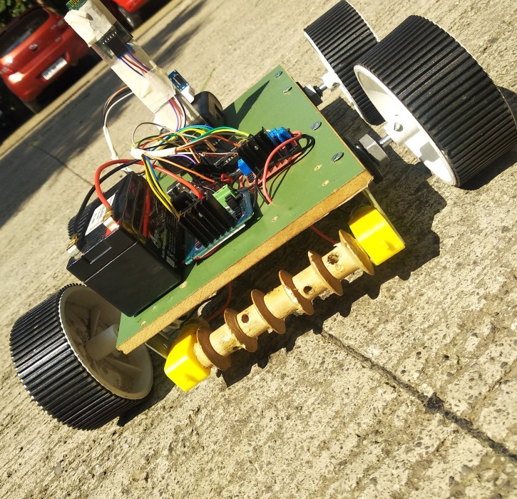

Slide 8
Target Beneficiary group:
This system is beneficial for all the farmers for weeding purpose. Instead of working with machine by physically presenting, we can operate the machine by seating at one place. Mobility problems can be solved using this system.
This system can work day and night.
This system will help famers in reducing the work load, cost of labour, and time.
It will help the farmers to enhance the quantity of crop production.

Slide 9
Financial implementation of village
Using the AgroWeeder it will make the village smart and automated.
This would make the first smart village which would reduce the fuel consummation ,time consummation, and many more things.

Slide 10
Thank You

